Slide 1




PART 4 · WIRESHARK ANALYSIS
Introduction to Wireshark
What is Wireshark?
A free, open-source network protocol analyzer used to capture and inspect traffic in real time.
Packet Capture
Wireshark listens on a network interface and records every packet, including its full header and payload.
Packet Analysis
Captured packets are decoded layer-by-layer against the OSI model, from Ethernet up to the Application layer.
TLS Filter
The display filter tls (or ssl) isolates only TLS handshake and application-data records for focused analysis.
14

Slide 2
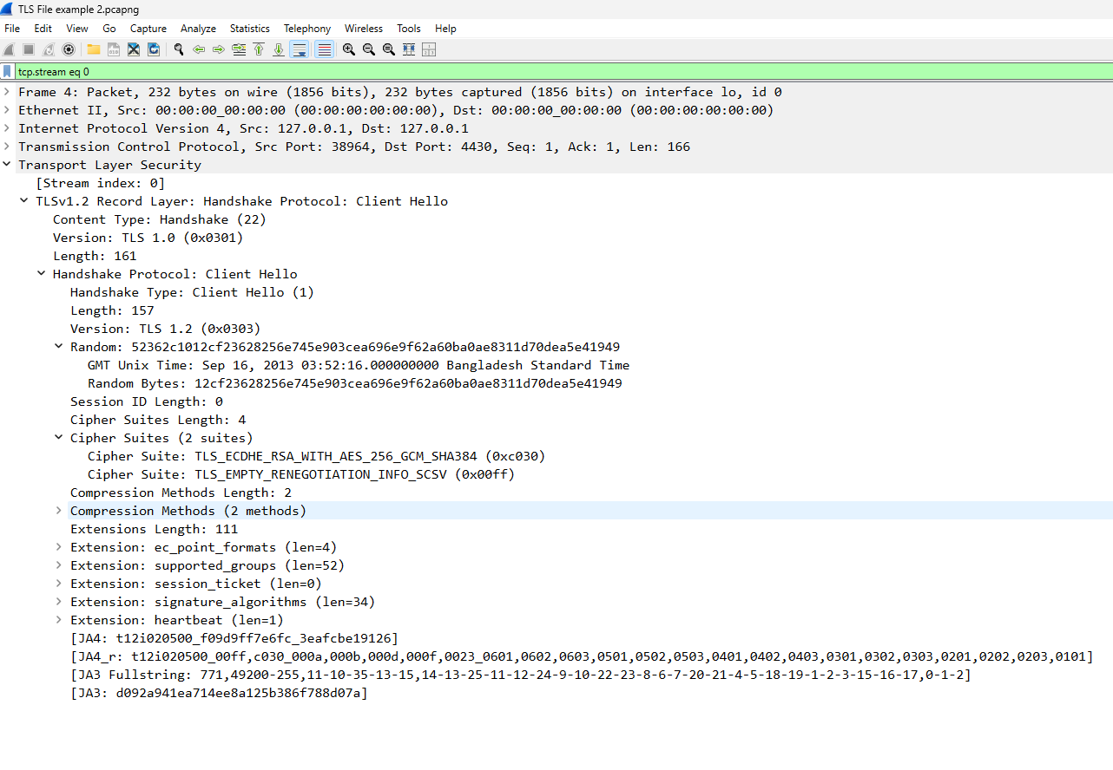

PART 4 · WIRESHARK ANALYSIS
Client Hello Analysis
TLS Version: highest protocol version the client supports.
Random: 32-byte client-generated value used in later key derivation.
Cipher Suites: the ordered list of encryption combinations the client offers.
Extensions: e.g. SNI (requested hostname), supported groups, ALPN.
15

Slide 3
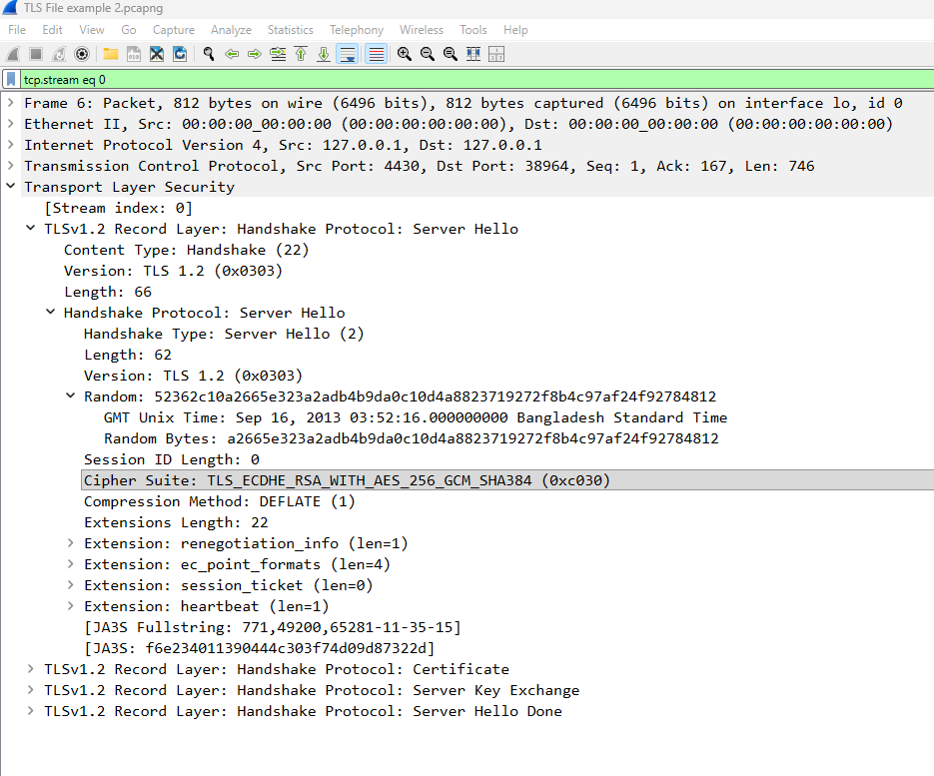
PART 4 · WIRESHARK ANALYSIS
Server Hello Analysis
Selected TLS Version: the protocol version the server has chosen to use.
Selected Cipher Suite: the single suite chosen from the client's offered list.
Session ID: identifier that may allow the session to be resumed later.
Server Random: combined with the client random to derive session keys.
16

Slide 4
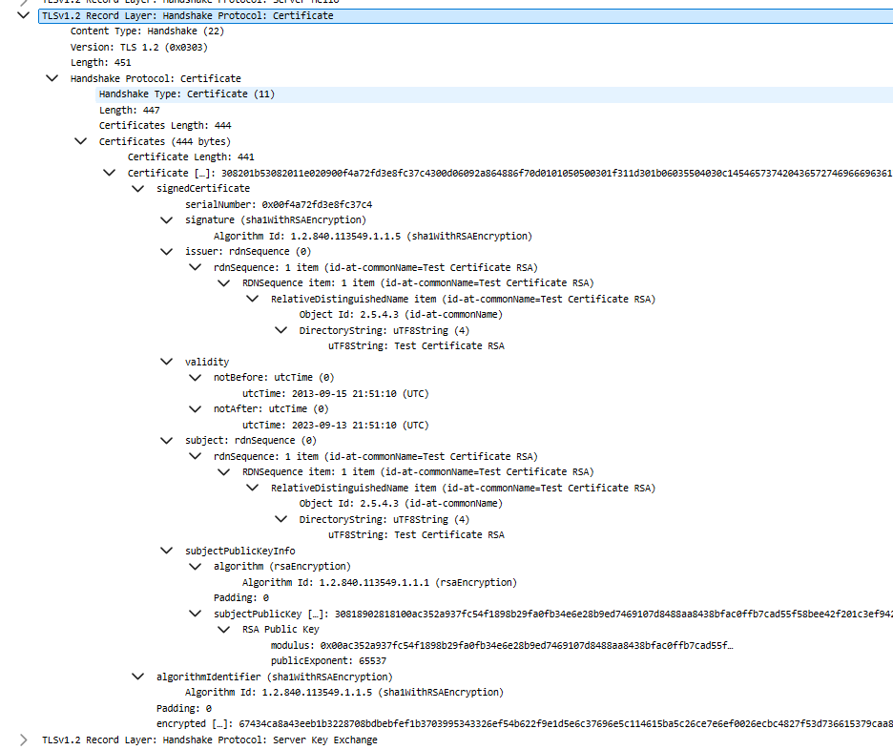
PART 4 · WIRESHARK ANALYSIS
Certificate Analysis
Subject: the entity (domain/organization) the certificate was issued to.
Issuer: the Certificate Authority that signed the certificate.
Public Key: the key bound to this certificate, used for authentication.
Validity: the certificate's not-before / not-after date range.
Signature Algorithm: e.g., SHA256withRSA, used to sign the certificate.
17

Slide 5

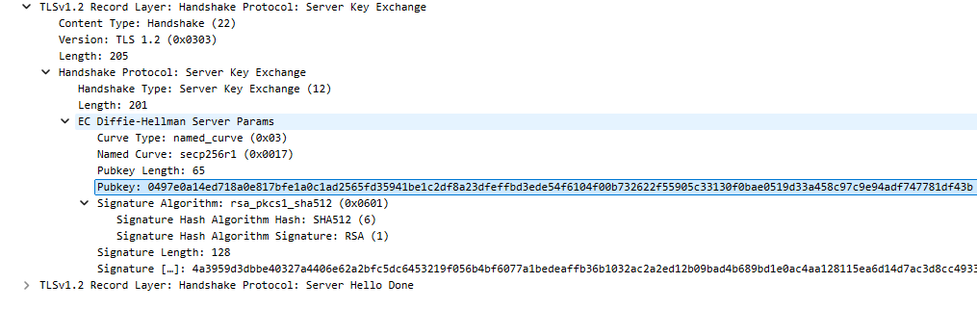
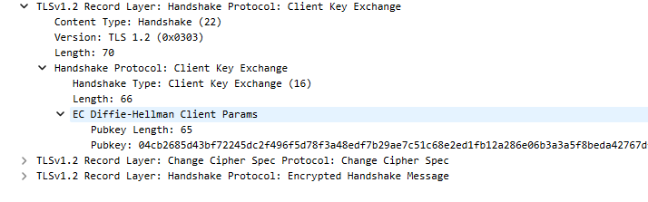
PART 5 · WIRESHARK ANALYSIS (CONT.)
Server & Client Key Exchange
Key Exchange: the mechanism (e.g. ECDHE) used to agree on secret material without sending it in plaintext.
Shared Secret: a value both sides compute independently that never travels across the network.
Session Key: derived from the shared secret and both random values; used to encrypt all further traffic.
Figure: Server Key Exchange
Figure: Client Key Exchange
18

Slide 6
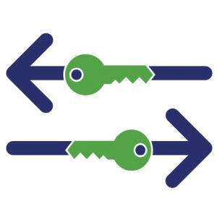
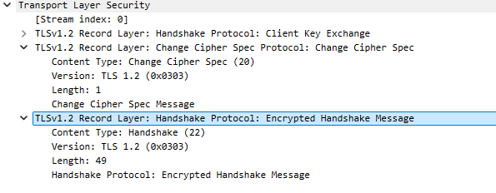
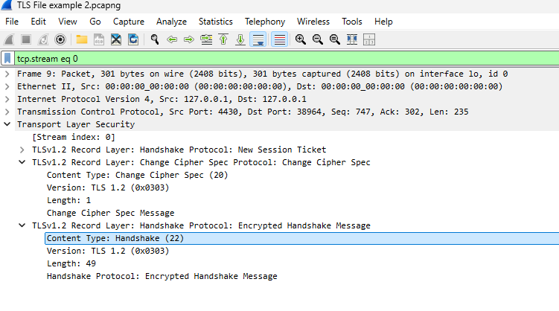
PART 5 · WIRESHARK ANALYSIS (CONT.)
Change Cipher Spec & Finished
Change Cipher Spec signals that all subsequent records will be encrypted using the newly agreed session key.
Encryption begins: from this point, both sides switch from plaintext handshake messages to encrypted records.
Finished: the first encrypted message, verifying the handshake was not tampered with — handshake complete.
19

